Slide 1
S.O.L.I.D. programming principle
Single responsibility principle
Open-closed principle
Liskov substitution principle
Interface segregation principle
Dependency inversion principle
Why SOLID principles?
To prevent the problems that have occurred or will occur in the future due to change or updates in the software .

Slide 2
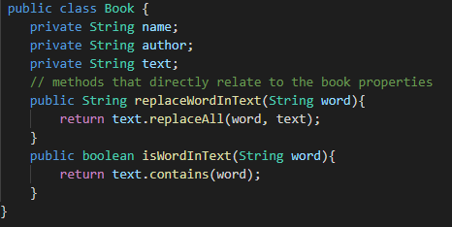
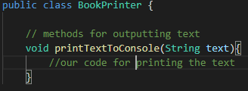
Single responsibility- every class or module should have responsibility over a single part of the functionality provided by the software and that responsibility should be encapsulated by the class or module .
So, a class should have only one reason to change which is its narrowed responsibility .
Example - this book class sole
responsibility is to maintain books
info. To print book we need to have
Separate class with this responsibility
Only.

Slide 3

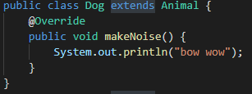
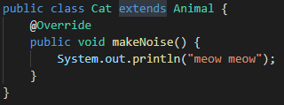
Liskov substitution- subclasses must be able to replace their parent classes .
Barber liskov gave this . It means a superclass object can be replaced by a sub-class object without altering any provable properties of that program .
Both subclasses can be replaced at animal class where it is required .

Slide 4

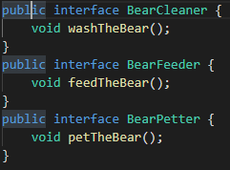
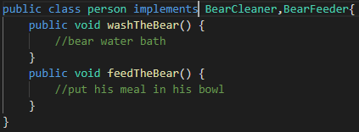
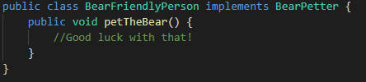
Interface segregation –Used to design good class and also in writing unit test cases .
Must keep everything minimum like interfaces ,attributes ,methods or classes etc .

Slide 5
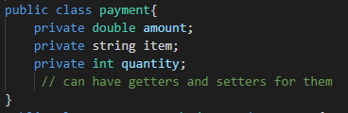

Open-closed- this promotes adding features to classes by creating subclasses there should be no need to change in working class . Bringing a change in that means that class was not closed for modification .
So, any class, modules or functions must be closed for modification but open for extension .
Example- we have a payment class for
Storing payments now if we get an update
On methods of payment so we can extend
Another class but should not modify in
The same class.

Slide 6
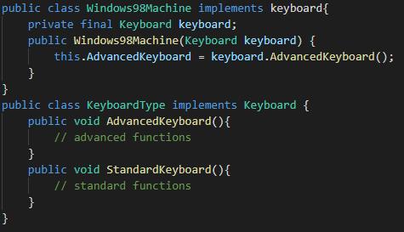
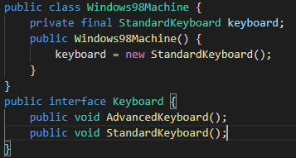
Dependency inversion- focuses on packaging the code .high level module should not depend on low-level modules. Both should depend on abstraction .
Direct dependency- when a concrete class depends on another concrete class .
Inverted dependency- when a concrete class depends only on an abstract interface . Example-
What if I want to use advanced
keyboard instead of standard one in
98 machine only.
So, now in same class change is not
required Only implement that
interface and Call constructor
with new Parameters .

Slide 7
Object Oriented Programming Concepts
What is OOP ?
OBJECT- region of memory, that contains value and are referenced by identifiers.
OOP - So those object (or values) related programming is OOP .
OOP Languages - c++, java, Python , JS etc.
Why is OOP ?
The main aim of OOP is to bind together the data and the functions that operate on them so that no other part of the code can access this data except those functions.

Slide 8
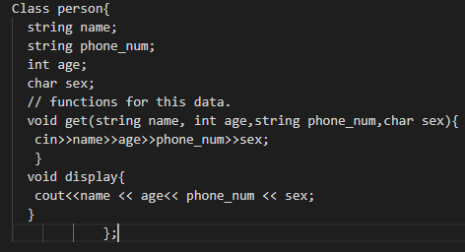
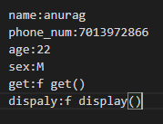
Classes- Blueprints for your data .
Objects(entities)- Are those data values .
OOP’s features –
Encapsulation –Binding the data and functions related to it in a single unit and methods will hidden from other classes but accessible only from same class .

Slide 9
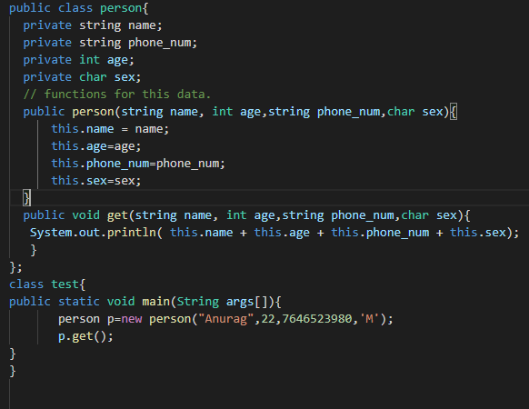
Here we can access all properties only by object and limited .

Slide 10
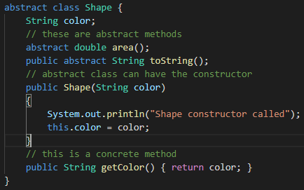
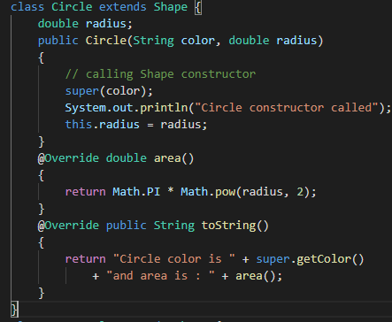
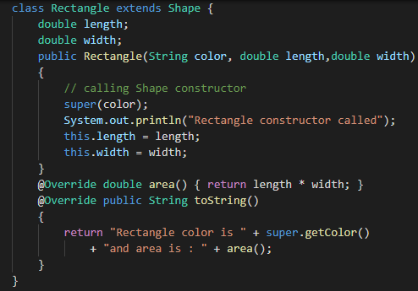
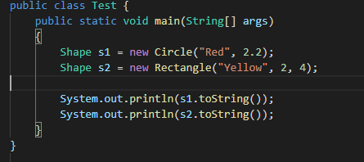
Abstraction – hiding unneccesary details and showing only essential parts.
Like ex- Abstraction can be
Achieved in 2 ways-
1 abstract classes
We can have 0 to 100%
Abstraction .
2 Interfaces
We can have 100%
Abstraction only .

Slide 11


Abstract class Abstract class can have abstract and non-abstract methods. | Interface Interface can have only abstract methods. Since Java 8, it can have default and static methods also.
Abstract class doesn't support multiple inheritance. | Interface supports multiple inheritance.
Abstract class can have final, non-final, static and non-static variables. | Interface has only static and final variables.
Abstract class can provide the implementation of interface. | Interface can't provide the implementation of abstract class.
An abstract class can extend another Java class and implement multiple Java interfaces. | An interface can extend another Java interface only.
An abstract class can be extended using keyword "extends". | An interface can be implemented using keyword "implements".
A Java abstract class can have class members like private, protected, etc. | Members of a Java interface are public by default.

Slide 12
Constructor – It is a function that is called automatically when object of a class is created. If it is not created by user then compiler does it automatically .
Types of constructors -
Default constructor- automatically created by compiler if user forgot to create it.
parameterized constructor- constructor with parameters .
Copy constructor- that takes same class type as parameter and copies that objects data into another .
Polymorphism - performing single action in different ways . There are two kinds of polymorphism .

Slide 13
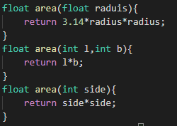
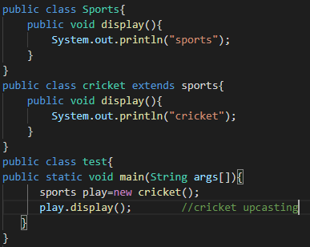
Why polymorphism ? polymorphism allows you to define one interface and have multiple implementations.
Types of polymorphism .
Compile time polymorphism run time polymorphism
function overloading function overriding

Slide 14
Inheritance - when derived class inherits properties and behaviors of its base class that is known as inheritance .
Why inheritance ?
Because it provides code re-usability. In place of writing the same code, again and again, we can simply inherit the properties of one class into the other.
Types of relationships –
IS-A Relationship inheritance: In java by using "extends" keywords we can implement IS-A relationship. The main advantage of IS-A relationship is that its reusable .
HAS-A relationship : This is also known as composition (or) aggregation. we can implement HAS-A relationship using new operator .

Slide 15


Composition: Without existing container object if there is no chance of existing contained objects then the relationship between container object and contained object is called composition which is a strong association.
Aggregation : Without existing container object if there is a chance of existing contained objects such type of relationship is called aggregation. In aggregation objects have weak association.
Single level inheritance-Inherits Only upto a single level.
Multi level inheritance- Can inherit upto multiple levels .

Slide 16

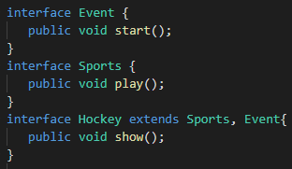
Hierarchal inheritance- a parent is inherited by many subclasses .
Multiple inheritance- when a subclass inherits more that one parents .and there is no ambiguity problem with interfaces because while implementing class define that methods .

Slide 17

Hybrid Inheritance - A hybrid inheritance is a combination of more than one types of inheritance.

